Slide 1

The Work of WomenSV
(Women of Silicon Valley)
By Ruth Darlene, M.A.
Executive Director, WomenSV
info@womensv.org | 833-966-3678 | www.womensv.org
Notes:
Good evening honorable members of the City Executive Committee.
Thank you for giving me a few minutes to share some information with you about the work and mission of WomenSV—a program that serves women who are trapped in a relationship with a powerful, sophisticated abuser. One who generally has a very positive image in the community but a very different dark side behind closed doors that only his wife and children ever see.

Slide 2

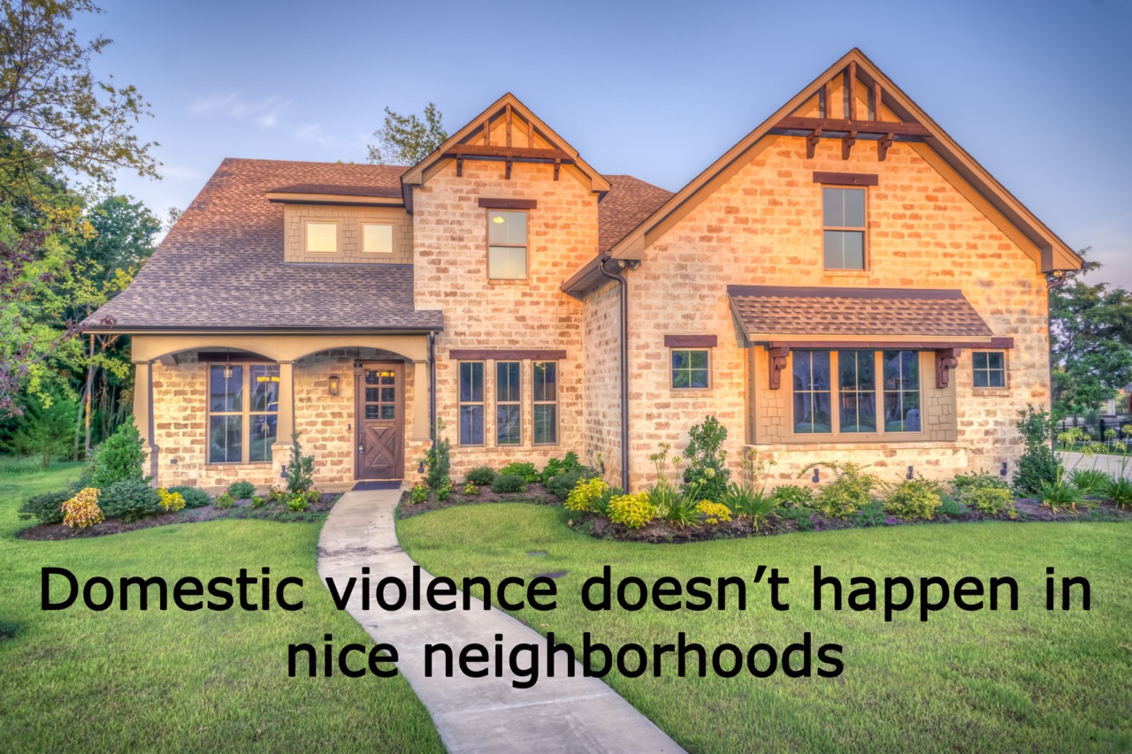

Public Perception
Notes:
We have this idea that DV doesn't happen in nicer areas--but the truth is we are just better at hiding it.
There is so much shame and social stigma attached to this problem in this demographic--and the forms of abuse they are subjected to can be so subtle—it’s often hard for survivors to reach out for help—
Survivors in this demographic tend NOT to reach out to hospitals, or shelter-based agencies or the police for help--the very providers that keep track of DV data.
Even if she ends up going to the hospital, she may not feel safe disclosing the true cause of her injuries. And if he goes with her, he will spin a story about what happened. So vital to interview her away from her partner.
Re Susan Weitzman, clinical psychologist treating DV survivors in upscale neighborhoods, the more money their partners had, the more afraid the women were of being killed if they left, if not by their partner directly, then by a third party
.

Slide 3
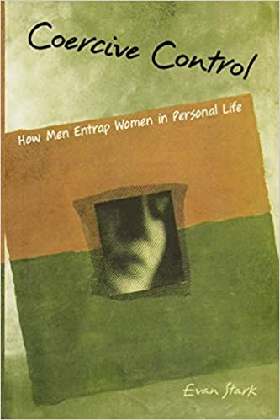
The problem: coercive control…
A pattern of controlling, isolating, and threatening behavior.
Examples: emotional, financial, legal, tech, emotional, sexual, physical abuse
Ranges from gaslighting to strangulation
Lethality risk
35% of WomenSV clients have experienced non-fatal strangulation.
Stark, E. (2007). Coercive Control: How Men Entrap Women in Personal Life. Oxford University Press.
Notes:
We are here to supplement existing DV agency services that focus on addressing physical and sexual violence
We do address physical and sexual violence but our area of speciatly is coercive control—the more subtle forms of abuse perpetrated by powerful, sophiostictaed bausers
It involves a pattern of controlling, threatening, isolating behavior
It’s typically a gender-based crime, although there are controlling women, and children can be victims of coercive control by either parent—Mommy Dearest.
but it tends to be a gender-based crime perpetrated by men against women.
That's according to Dr. Evan Stark, the world-renowned expert on coercive control wrote the book "coercive control: how men entrap women in personal life."
He calls coercive control a liberty crime because it violates a woman's fundamental right to be free and safe in her own home.
It ranges from emotional abuse to strangulation—
CLICK
about 35% of our survivors have experienced non-fatal strangulation at the hands of their partner—their lawyer, engineer, doctor, therapist, religious leader-partner
Coercive control is a lethality risk right up there with ending the relationship, pregnancy, and owning a gun
Not only does it rob victims of their basic human right to peace and safety and freedom, it erodes their sense of agency, self-sufficiency, independence and over time, their sense of self, of personhood
I call it the ultimate form of identity theft because it robs the victim of who they once were before all these things—their freedom, their peace, their safety, their independence--were taken away from them

Slide 4
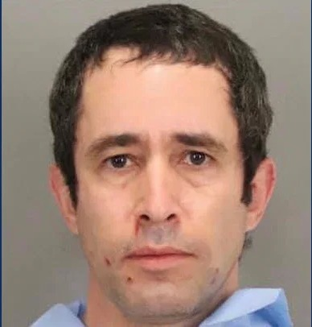
Engineer
https://www.nbcbayarea.com/news/local/sunnyvale-man-arrested-in-double-homicide-involving-his-wife-daughter/2449612/
Notes:
An example of the ultimate act of domestic violence happened just earlier this year in an upper middle class neighborhood, committed by a professional..
Leonid Yamburg, Silicon Valley engineer from Sunnyvale.
No prior reported history of domestic violence.
In January of this year, he was arrested on suspicion of double murder after he walked into police headquarters and confessed to killing his wife.
Officers later found his wife and his 11-year-old daughter dead at the scene.

Slide 5
Abuse crosses all economic lines…
Power and control dynamics are similar across all income levels but…
More money + more power = more resources to exercise that power and control
Higher social status, public image and credentials make it easier to hide a darker side
Affluent abusers have the power, money, influence, and technical expertise to make it hard for a woman to:
Leave safely and stay safe
Keep custody of her children
Avoid crippling debt, bankruptcy, poverty, homelessness

Slide 6

Our Mission
Our mission: to empower survivors, train providers and educate the community to break the cycle of covert abuse and coercive control in intimate partner relationships.
Notes:
Here’s what we are doing about this problem.
Our goal is to empower survivors, train providers and educate the community to break the cycle of covert abuse and coercive control in intimate partner relationships.

Slide 7
Our Focus
Hidden victims in middle to upper income areas trapped in a relationship with a powerful, sophisticated abuser
Uses more covert forms of abuse that can be hard to identify
Emotional, financial, legal, technological and other forms of coercive control
Notes:
On the surface they may appear to be living a life of privilege but in reality these women are often trapped in a relationship with a sophisticated abuser who threatens to destroy them in every conceivable way if they ever should leave.
In working with our survivors, we address the more obvious forms of abuse such as physical and sexual violence, but we also have a unique area of focus on other types of abuse such as emotional, financial, legal and technological, and other behaviors that are controlling, isolating and threatening but harder to identify, because they don't leave visible wounds.

Slide 8

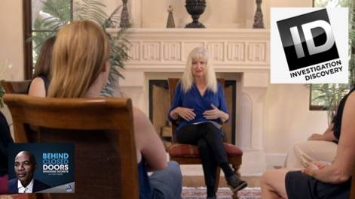
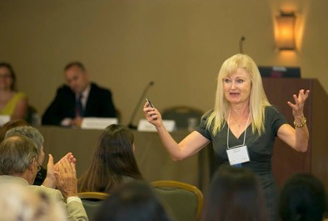
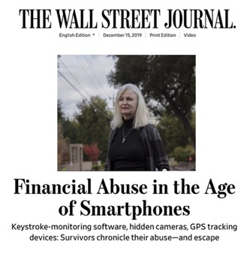
Our Services
Direct Client Support
Trainings for Providers
Public Presentations/Media Interviews/Column
Notes:
EDIT!!!! There are 3 parts to our program
The first is direct client services which include a helpline; a weekly support group;
ongoing individual meetings where we develop a close personal relationship with each survivor and continue to meet with them individually for as long as they want—in many cases, for years!
Our survivors come from all different races, countries, religions and cultural backgrounds. The one thing they all have in common is being trapped in a relationship with a sophisticated abuser.
We also connect our survivors with resources depending on what they need--private investigators, cybersecurity experts, financial analysts.
We provide survivors with gift cards if needed, or a burner phone and sometimes a basic laptop if their electronics have been compromised. Here. In Silicon Valley, technological abuse is VERY common.
We don't charge survivors for our services because we believe it's every woman's right and every child's right to be free and safe in their own home and they shouldn't have to pay to exercise that right. That's one reason.
But another is because of the rampant financial abuse in this demographic. On paper they may look like they come from a background of privilege but the reality is often something altogether different where their abuser has taken total control of their resources and plunged them into crippling debt or bankruptcy.
The second part of our program is professional education. I was a teacher before becoming an advocate and education continues to be very important to me. Knowledge is power and when it comes to domestic violence, education is one of the most effective forms of intervention--the earlier the better. So we do professional trainings for providers to help them become more trauma informed in working with this population.
the third part of our program is community outreach. We give public presentations for employers, service clubs and schools--to raise awareness about domestic violence and coercive control.
And I write a column on coercive control and do interviews with other media as well

Slide 9
Our Partnerships include
Los Altos City Council, Police Department and Town Crier
Cupertino City Council, Public Safety Commission and Public Safety Forum
Mountain View, Sunnyvale, Los Altos Police Departments, Cupertino Substation
SCC DV Conference and SCC Probation Department
DVDRT and SCC Police Chiefs Protocol
De Anza College Nursing Program, Valley Med Center OB-GYN’s and Kaiser San Jose and Kaiser Santa Clara physicians
Juana Briones Summer program at Los Altos History Museum with multiple high schools throughout SCC addressing teen dating violence
Notes:
In terms of our outreach, some examples include our partnerships with law enforcement and health care
We receive some generous funding from Los Altos City Council and partner closely with the los Altos Police Department, doing trainings for their officers and bringing survivors over to do safety planning. Their officers also come to our support group to educate our survivors about their rights.
I also have a column in the Town Crier on covert abuse to help raise public awareness about this issue.
We’ve done talks for the Cupertino city Council, their Public Safety Commission and have one coming up for their Public Safety Forum
We’ve also brought survivors over to consult with officers at the police stations in MV, Sunnyvale, and LA police stations as well as the Cupertino substation
And I’ve done trainings for the officers at many police departments in SCC and have one coming up for the SCC probation department.
I also serve on the DVDRT and help edit the SCC police chiefs DV protocol and create the DVDRT Annual Report based on the cases we review of DV homicides.
We also do trainings for health care practitioners to help them become more trauma informed in serving their patients.
We’ve done a number of trainings for high school students and teachers but we would like to do more because we believe that when it comes to DV education is the best form of prevention

Slide 10

Our Impact--1
Over the past 10 years, WomenSV has served over
women suffering at the hands of powerful, sophisticated abusers
1,000
Last fiscal year, we served 216 survivors, providing the following services:
Notes:
Since we started 10 years ago, it’s our 10 year anniversary!--WomenSV has served about 1,000 survivors of covert abuse.
Last fiscal year was our busiest yet – we served 216 survivors.
Of these 1000 women, most are in the communities you lead

Slide 11
Our Challenges
Serving over 1,000 women in this. Past 10 years we have established the need for this kind of service and our progress in filling it
Shifting to virtual support
Meeting the need—long wait times, referrals to other agencies*
staffing we need two more advocates
Education—reaching the schools to educate youth about coercive control
Growth
Fundraising
Notes:
We are working very hard to meet the need but it's getting more and more challenging to keep up with the demand, given our tiny team--small but mighty! but still small.
We’re having to make survivors wait sometimes 4-6 weeks for an appointment. So we refer survivors to our sister agencies in the county while they're waiting, in order to provide additional support and services.
But we MUST hire more advocates to meet the need.
And we want to do more outreach into the schools to educate young people, to help them recognize early warning signs of controlling behavior—not just for physical and sexual violence but also for financial, tech and emotional abuse. I was a teacher before becoming a DV advocate and I still believe the best form of prevention when it comes to domestic violence is education and the earlier the better. So we are working on a curriculum now to propose to the schools.
But this all takes funding!
And we don't charge survivors for our services because we believe it's their fundamental human right to be free and safe in their own home--but also because of the rampant financial abuse in this demographic. Many are facing extreme poverty and some have become homeless.
So we have to find other ways to raise money.

Slide 12
WSV is committed to building partnerships and bridges across Silicon Valley and across the country!
WomenSV is looking forward to collaborating with all of you as we work together to protect the right of every man, woman and child to be free and safe in their own home!
Notes:
It can be hard for a survivor to recognize what’s happening to her, the tactics being used on her and the impact they are having on her—especially if he has a respected position in the community.
Covert abusers are wily and it’s easy to be taken in by their charm and credentials.
That’s why partnerships are so important because it really does take a village when it comes to addressing covert abuse and coercive control.
We hope you'll consider partnering with us as well as we look forward to serving more and more residents here in santa clara county.
If we all work on this together, we can continue to protect the right of every woman and child to be free and safe in their own home.
When budget time comes around I hope you will consider supporting WomenSV’s work and our efforts to help overcome the oppression of domestic abuse at the hands of a powerful, sophisticated abuser, so they can go on to build safer, healthier lives for themselves and for their children
Thank you so much for your kind attention today.
You know, as hard as it is to live with an abuser it’s almost impossible to leave without outside help. Over 70% of domestic violence incidents happen after a woman leaves her abuser.
If it takes a village to raise a child, it takes another village to leave an abuser!
With your help, we can all be that village and continue to reach more and more survivors who are struggling to build a safer life for themselves and for their children.
We look forward to collaborating with all of you as we work together to protect the right of every man, woman and child to be free and safe in their own home!

Slide 13
www.womensv.org
Phone: 833-WOMENSV
or
833-966-3678
info@womensv.org
833-WOMENSV/833-966-3678
Notes:
Website and email address.

