Slide 1

Work Program C1 – Briefing on the
Santa Clara/Santa Cruz Counties/Airport Community Roundtable
September 11, 2019
LAX/Community Noise Roundtable

Slide 2
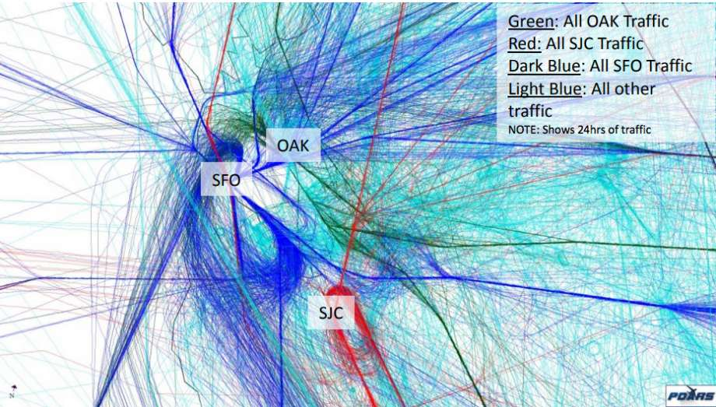
Presentation Outline
Presentation Outline
Purpose of this Briefing
Genesis of the Santa Clara/Santa Cruz Counties/Airport Community Roundtable (SCSC Roundtable)
SCSC Roundtable Membership
Meeting Location, Frequency,
and Accessibility
SCSC Website
Accomplishments
Resources
Summary
Source: Federal Aviation Administration

Slide 3
Presentation Outline
Purpose of this Briefing
LAX/Airport Community Roundtable Work Program Item C1, “Establish Working Relationships with Other Roundtables,” expresses the Roundtable membership’s “. . .desire to establish formal ongoing working relationships with other airport noise Roundtables or other community forums.”
The LAX Roundtable Facilitator is charged with arranging for guest speakers from other airport noise forums
I serve as the Consultant/Facilitator for the SCSC Roundtable and I’m delighted to share the background on the SCSC Roundtable with the LAX/Community Noise Roundtable
The SCSC Roundtable Chairperson Mary-Lynne Bernald asked me to extend her greetings to you

Slide 4
Presentation Outline
Purpose of this Briefing (cont.)
There have been several presentations by other Roundtable’s/Noise Forums to the LAX/Community Noise Roundtable including representatives from the:
  San Francisco International Airport/Community Roundtable, and
  Portland International Airport Citizen’s Noise Advisory Committee
The benefit of interacting with other Roundtables is to:
  Consider different approaches to addressing aircraft noise issues,
  Learn about alternative formation and meeting approaches,
  Leverage common concerns for airline and legislative body consideration/action, and
  Share experiences to reduce the learning curve and expedite the development of solutions

Slide 5
Presentation Outline
Genesis of the SCSC Roundtable
The SCSC Roundtable was formed as a follow-on public forum to the “Select Committee on South Bay Arrivals” (Select Committee) and the “San Jose International Airport Ad Hoc Advisory Committee on South Flow Arrivals” (SJC Ad Hoc Committee)
The Select Committee and SJC Ad Hoc Committee were formed in response to widespread community complaints regarding changes in aircraft noise exposure resulting from the implementation of the Northern California Metroplex flight procedures for San Francisco International Airport (SFO), San Jose International Airport (SJC), and Oakland International Airport (OAK)
The Select Committee and SJC Ad Hoc Committee met for several months, forwarded numerous noise abatement recommendations to the FAA for its consideration, and disbanded
Congressional representatives in the region saw the need for a follow-on organization and continued public input process, so work began on forming the SCSC Roundtable

Slide 6

Presentation Outline
Genesis of the SCSC Roundtable (cont.)
The Cities Association of Santa Clara County took the lead role in working with potential member agencies to develop a Memorandum of Understanding upon which the new SCSC Roundtable would be based
The Cities Association also serves as the financial body through which membership fees are paid and consultant activity for the SCSC Roundtable is funded
The SCSC Roundtable is funded by the member agencies via
a prorated formula based on population
Of the 21 cities and counties invited to join the SCSC Roundtable,
11 cities and 2 counties have chosen to become members
There are no airport members on the SCSC Roundtable
Source: Cities Association of Santa Clara County

Slide 7
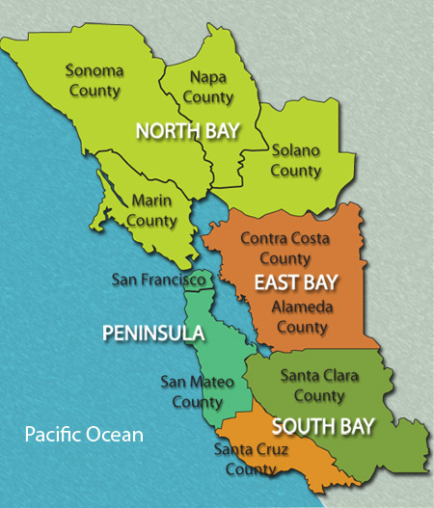
Presentation Outline
SCSC Roundtable Membership
The following cities and counties comprise the SCSC Roundtable Membership:
City of Capitola
City of Cupertino
City of Los Altos
City of Los Altos Hills
City of Monte Sereno
City of Mountain View
City of Palo Alto
City of Santa Clara
City of Santa Cruz
City of Saratoga
City of Sunnyvale
County of Santa Clara
County of Santa Cruz
Source: Beeline Glass Co. Inc.

Slide 8
Presentation Outline
SCSC Roundtable Membership (cont.)
The SCSC Roundtable Membership is comprised of elected city officials and elected county officials or designated county staff members
There are no community group or neighborhood association representatives on the SCSC Roundtable
  Residents are not permitted to represent cities or counties on the Roundtable
FAA staff have attended and participated in every meeting
  The FAA has committed to providing Technical Support staff at the SCSC Roundtable meetings on an every-other-month basis

Slide 9
Presentation Outline
SCSC Roundtable Membership (cont.)
SFO Airport Noise Abatement Office staff have attended and participated in every meeting
Staff from the congressional offices of Anna Eshoo, Ro Khanna, and Jimmy Panetta regularly attend the SCSC Roundtable meetings
To date, the City of San Jose and San Jose International Airport have declined to participate in the SCSC Roundtable, but discussions are ongoing

Slide 10
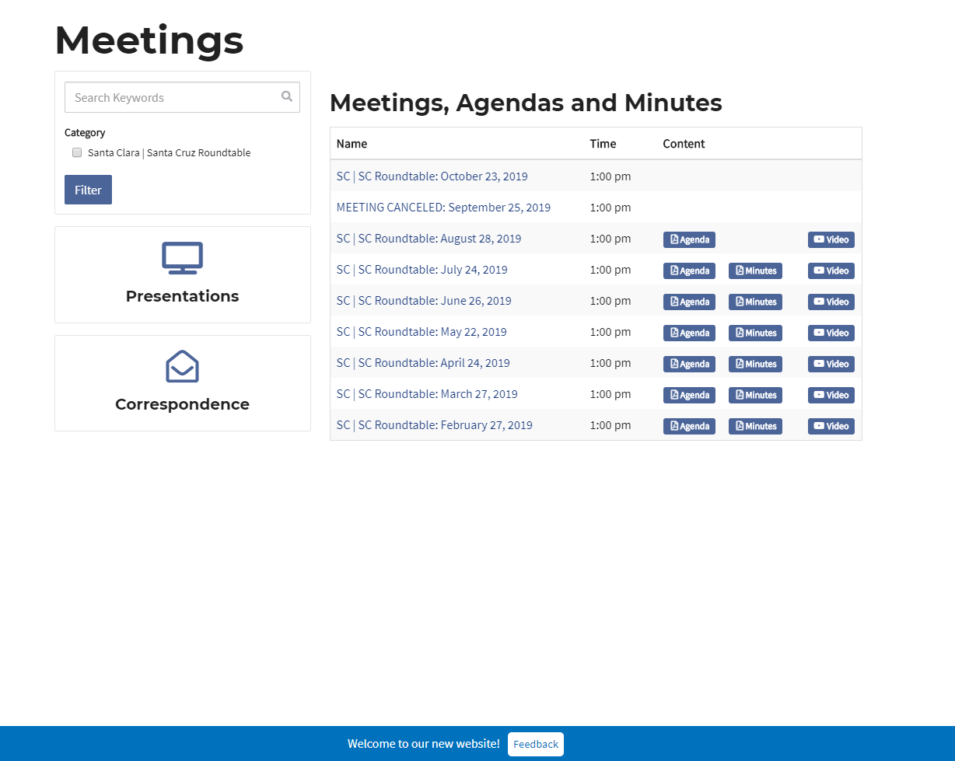
Presentation Outline
Meeting Location, Frequency, and Accessibility
The SCSC Roundtable meets at various locations throughout Santa Clara and Santa Cruz Counties
Meeting locations must meet several requirements including ADA accessibility, sufficient dais space and microphones to accommodate the 13 members, sufficient seating space to accommodate the interested public, active staff assistance at the meeting site during the SCSC Roundtable meetings, and live-meeting broadcast capabilities
To date, SCSC Roundtable meetings have occurred in
San Jose, Santa Clara, and Santa Cruz
The SCSC Roundtable currently meets during the day
from 1 to 3 pm
Source: SCSC Roundtable

Slide 11
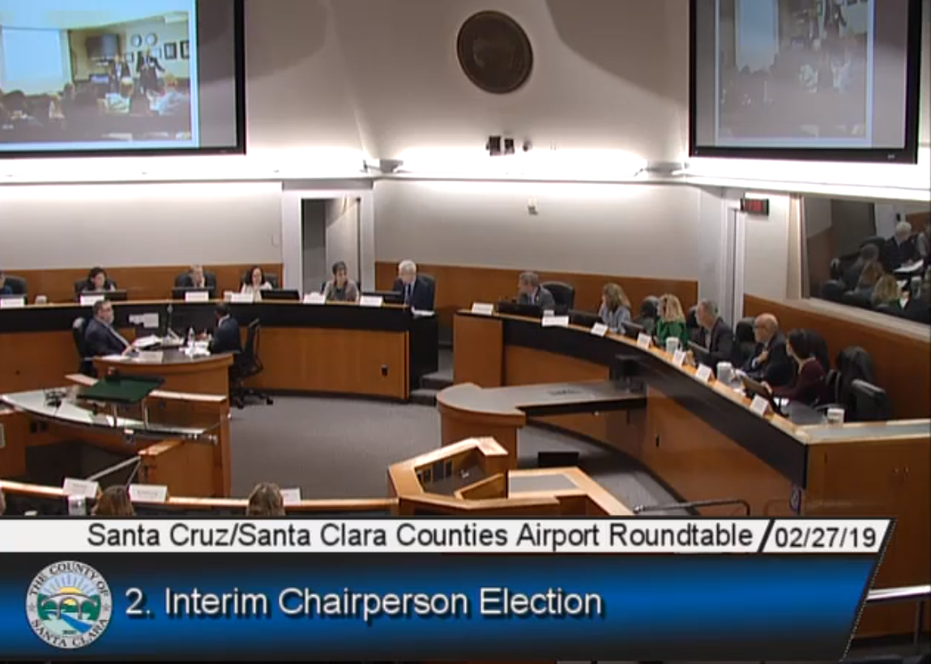
Presentation Outline
Meeting Location, Frequency, and Accessibility (cont.)
The SCSC Roundtable has been meeting monthly since February 2019, but voted in August to consider moving to an every-other-month schedule
The SCSC meetings are live-streamed over a local-access cable channel
The meeting video is recorded and posted on the SCSC Roundtable website shortly after the meeting
All of the meetings have been well attended by both
the Roundtable members and the public
The next meeting is scheduled for Wednesday,
October 23, 2019 from 1 to 3 pm
  Instructions for watching the meeting live online are located
  on the SCSC Roundtable website at www.scscroundtable.org
Source: SCSC Roundtable

Slide 12
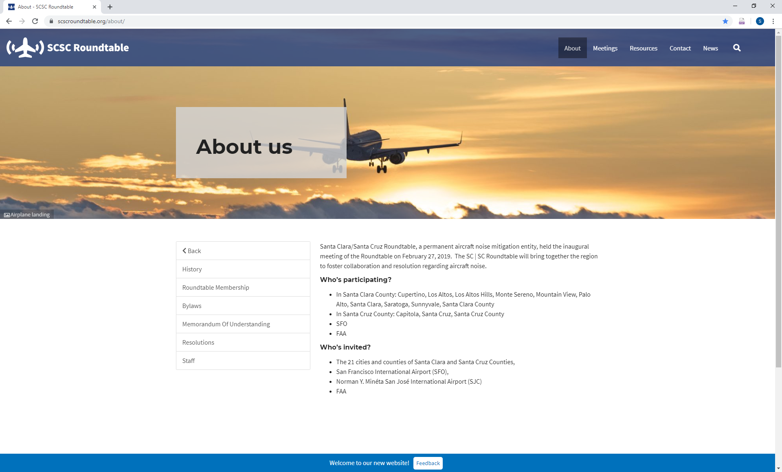
Presentation Outline
SCSC Roundtable Website: www.scscroundtable.org
The SCSC Roundtable website serves as a user-friendly hub of information for the Roundtable members and interested public
In addition to the traditional Bylaws, meeting agendas, past presentations, and correspondence, the SCSC Roundtable website also includes links to:
  Recent aviation-noise related news articles and press releases
  Community feedback tab, which allows for community
  input to upcoming meetings and topics of concern
  A list of the Roundtable members and staff
  Frequently Asked Questions
  Airport noise complaint websites
  Notices of Proposed Rulemaking
  Select Committee and SJC Ad Hoc Advisory Committee
  Reports and FAA Updates
Source: SCSC Roundtable

Slide 13
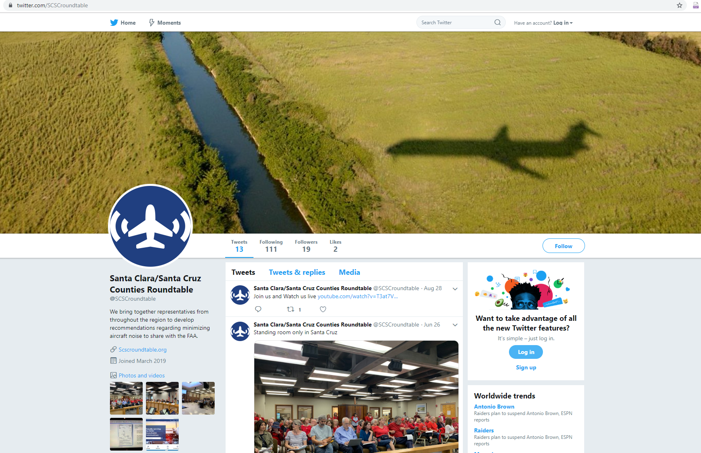
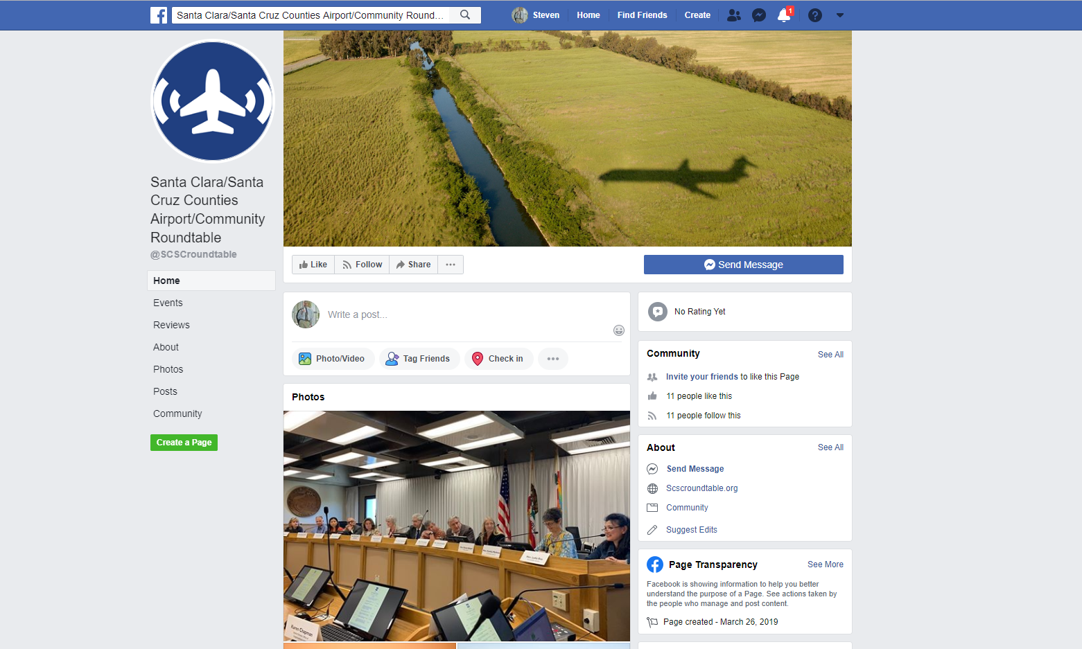
Presentation Outline
SCSC Roundtable Website: www.scscroundtable.org
The SCSC Roundtable also uses Facebook and Twitter social media accounts to broadcast information and to receive feedback:
Source: SCSC Roundtable
https://twitter.com/SCSCroundtable
Source: SCSC Roundtable
https://www.facebook.com/SCSCroundtable

Slide 14
Presentation Outline
SCSC Roundtable Accomplishments
The SCSC Roundtable is the newest airport/community noise roundtable in the country, but has been busy since its first meeting in February 2019. Here are a few of its accomplishments:
Elected a Chair and Vice Chair
Approved the SCSC Roundtable Bylaws
Livestreaming of the Roundtable meetings
Drafted a Strategic Plan and
Work Program
Established website/social media platforms
Submitted several letters to the FAA
with questions on flight procedures
Establishing relationships with the SFO
Airport Community Roundtable and OAK
Noise Forum
Developed a positive working relationship
with the FAA
Received several presentations by the
FAA on changes to certain flight procedures
Conducts a monthly review of the
Instrument Flight Procedure Gateway
Prepared tracking matrices on the status
of FAA’s implementation of the Select
and Ad Hoc Committee recommendations

Slide 15
Presentation Outline
Summary
The SCSC Roundtable fills the void that existed for communities that are impacted by aircraft noise from arrivals and departures to/from multiple San Francisco Bay Area airports, but did not have a forum through which to communicate their concerns to the FAA
The SCSC Roundtable provides a collaborative regional forum that invites public input, identifies aircraft noise concerns, and provides noise abatement recommendations to the regional airports and the FAA
The FAA prefers to work through airport community noise roundtables as they are intended to represent a regional consensus on aircraft noise-related issues
The FAA is evaluating flight procedure recommendations from the Select and SJC Ad Hoc Advisory Committees and has indicated that it will reach out to the SCSC Roundtable for assistance in identifying locations for public workshops should there be an environmental review process

Slide 16
Presentation Outline
Links to SCSC Roundtable Resources
Memorandum of Understanding: https://scscroundtable.org/documents/memorandum-of-understanding/
Bylaws: https://scscroundtable.org/documents/bylaws/
News: https://scscroundtable.org/news/
Meeting Dates, Agendas, and Videos: https://scscroundtable.org/meetings/
Twitter: https://twitter.com/SCSCroundtable
Facebook: https://www.facebook.com/SCSCroundtable
SJC Ad Hoc Committee Report: https://www.flysanjose.com/Ad_Hoc_Meetings
Select Committee Report: https://eshoo.house.gov/wp-content/uploads/2016/12/111716-Report-of-the-Select-Comm-on-SoBayArrvls-FINAL.pdf

Slide 17
Presentation Outline
Roundtable Member Questions?

