Slide 1

New Affirmatively Furthering Fair Housing Requirements in our Housing Element Update
Meeting Name
Date

Slide 2
AGENDA
Fair Housing Legislation
AB 686- Affirmatively Furthering Fair Housing
New Housing Element Requirements
Takeaways
Resources and Next Steps

Slide 3
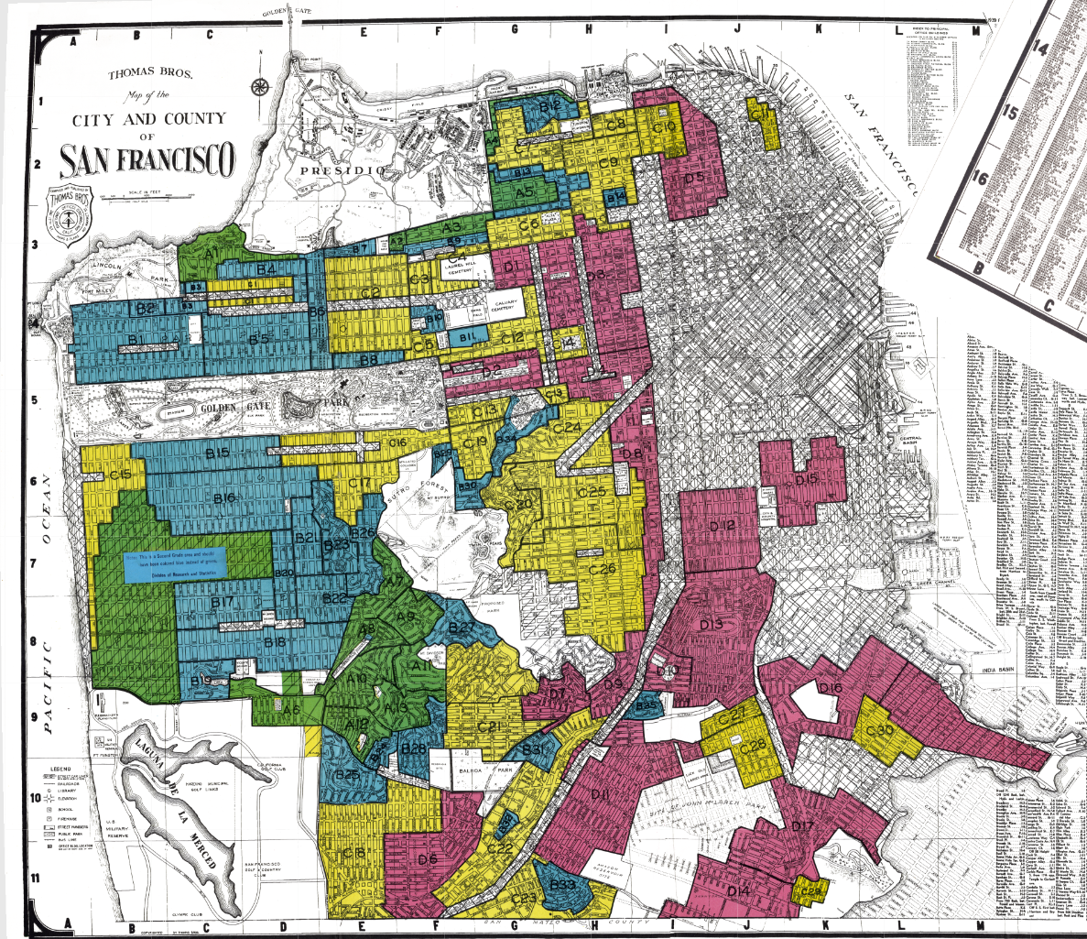
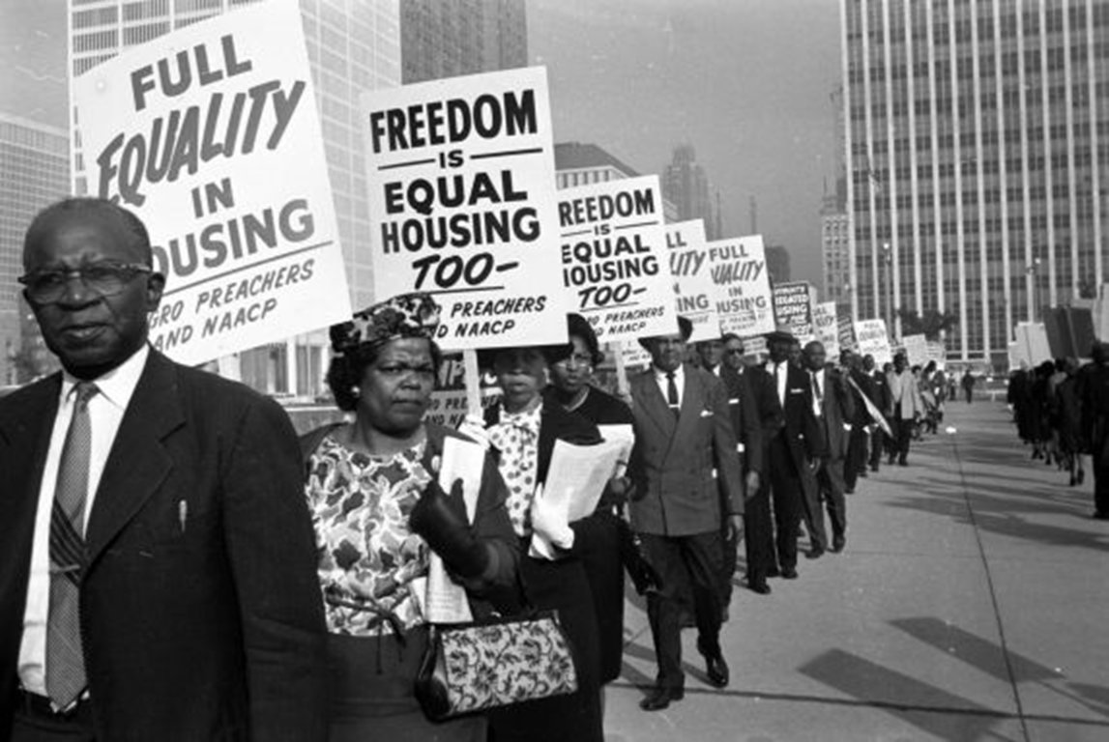
The Fair Housing Act (of 1968)
“Prohibited discrimination concerning the sale, rental, and financing of housing based on race, religion, national origin, sex, (and as amended) handicap and family status.”
Notes:
To combat a history of racial housing discrimination, segregation, and unequal access to opportunity, the Fair Housing Act was passed in 1968, which [read clause].
Fair housing aim to ensure that people have access to quality housing of their choice and the resources attached to place of residence regardless of their race, national origin, family status, religion, sex or disability, often referred to as protected classes (see California list of protected classes here)
However, in the nearly 50 years since the Fair Housing Act was enacted, housing inequality, lack of access to opportunity, and racial and socio-economic segregation have persisted.

Slide 4
California’s new Fair Housing Law
(AB 686)
Assembly Bill 686 (2018) defines Affirmatively Furthering Fair Housing (AFFH) as:
  “taking meaningful actions, in addition to combating discrimination, that overcome patterns of segregation and foster inclusive communities free from barriers that restrict access to opportunity based on protected characteristics”.
Notes:
Assembly Bill 686 (AB 686), passed in 2018, attempts to deepen California’s commitment to fair housing by requiring jurisdictions to “explicitly address, combat, and relieve disparities resulting from past and current patterns of segregation to foster more inclusive communities.” It builds on the 2015 Obama Affirmatively Furthering Fair Housing ruling and applies to all public agencies and added new requirements for the state-mandated Housing Element. According to the bill, AFFH means [read text]

Slide 5






AB 686:
Outreach
Assessment of Fair Housing
New Housing Element Requirements
ID and Prioritize Contributing Factors
Sites Inventory
Goals, Policies & Actions
Notes:
In April of this year, HCD published an AFFH guidance memo and data viewer mapping tool for compliance with AB 686. The new Housing Element requirements are housed within 5 core statutory elements: outreach, the assessment of fair housing, contributing factors, site inventory, and goals, policies and actions.
I’ll be providing a high level overview of these 5 elements for your information.

Slide 6
AB 686:
Outreach
New Housing Element Requirements
We will need to show how we engaged and incorporated input from protected classes and groups representative of our population (e.g., race/ethnicity, owner/renter, age, disability, family status, etc.)
Public input and local knowledge must be incorporated into our Assessment of Fair Housing
Notes:
Optional info to potentially present:
Geographic and transit access barriers to participation
Meetings scheduled outside of work hours, including evenings & weekends
Translating materials, ample time for review and avoiding overly technical language
National best practices encourage forming an equity advisory committee and providing mini-grants to community organizations to help with engagement
Examples of key stakeholders to engage with include:
Public housing authorities (PHAs)
Community-based organizations (CBOs)
Housing and community development providers
Lower income community members & households that include persons in protected classes
Fair housing agencies
Regional & independent living centers
Homelessness services agencies
Churches and community service organizations that serve ethnic/linguistic minorities
Who else should we make sure to engage?
For high resourced communities that may be lacking in protected classes and low income residents, consider widening who you consider to be part of your community to include not only those who reside in your jurisdiction, but also people who work there and commute in (e.g., teachers, public agency staff, gardeners, etc.). Some of this data can be collected from https://onthemap.ces.census.gov/. In addition, HCD recommends engaging local, regional, or statewide advocacy organizations in the outreach process (see page 21 of AFFH Guidance).

Slide 7
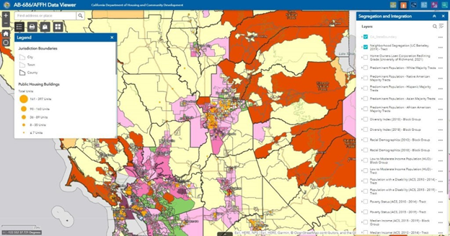
AB 686:
Assessment of Fair Housing (AFH)
Outreach
New Housing Element Requirements
We must include in our housing element update and assessment of:
  Fair Housing Outreach and Enforcement
  Segregation and Integration Patterns
  Disparities in Access to Opportunity
  Disproportionate Housing Need and Displacement
  Racially and Ethnically Concentrated Areas of Poverty (RE/CAP)
Each piece of the assessment must incorporate data analysis and local knowledge
Notes:
Important to note that many resources have been made available to help in this phase and that HCD will be paying close attention to the incorporation of local knowledge and data into this assessment. Some of this information can be gathered through our community outreach
Optional items to mention: ABAG and HCD tools to help in this exercise (AFFH data viewer, ABAG housing needs data, etc.)

Slide 8
AFH in [city]:
[insert POPEMP-03 Population By Race chart from your Housing Needs Data Packet spreadsheet]
Population By Race
Notes:
[Link: https://mtcdrive.app.box.com/s/nei8x775oi5m47mqhu8ctpyyqrioa2v3/folder/134776621160]
[Describe the racial/ethnic composition of your city in relation to the county and the region]

Slide 9
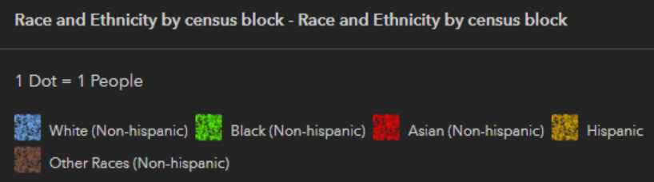
Racial Dot Map of [your city]
[insert racial dot map of your county with city encircled]
Notes:
[Link: https://mtc.maps.arcgis.com/apps/instant/media/index.html?appid=4a0188324a144172ab1c9fa6189163a5]
[Describe the spatial representation of the racial/ethnic composition of your city in relation to surrounding areas in your county and/or across the region]

Slide 10
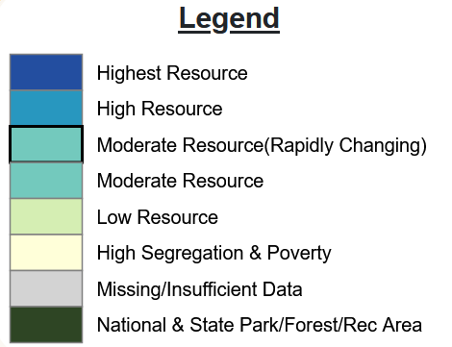
AFH in [county]:
[insert TCAC Map of your county with city encircled]
2021 TCAC/HCD Opportunity Map
Notes:
[Link: https://belonging.berkeley.edu/2021-tcac-opportunity-map]
When you zoom into [your] county and the city of [your city], you can see that our community is [local context]. This is a map of neighborhood opportunity map, created by TCAC/HCD These measures are determined by a combination of factors including: air quality, access to parks and open space, crime, school quality, and access to jobs etc.
Overlaying this information with the previous race/ethnicity data can help us better understand our segregation and access to neighborhood opportunity patterns.
Optional text
What this map doesn’t show is the regional racial disparities of the populations that live in different resource areas. Nearly half of the region’s White and Asian population lives in high and highest resource communities, whereas half of the region’s Latinx and more than half of the region’s Black population lives in low resource or high segregation & poverty neighborhoods (CA Fair Housing Task Force, 2019).
Also for regional context, ABAG/MTC have identified high resource areas, in addition to priority development areas and transit-rich areas, as a targeted growth geography in Plan Bay Area 2050. The Final RHNA Methodology and Draft Allocations adopted by the ABAG Executive Board in May, incorporate high opportunity areas as a heavily weighted factor in determining the allocation of low- and very low-income housing units. This methodology, and the inclusion of the Equity Adjustment, serve to satisfy affirmatively furthering fair housing, which is one of the 5 statutory objectives of RHNA.

Slide 11
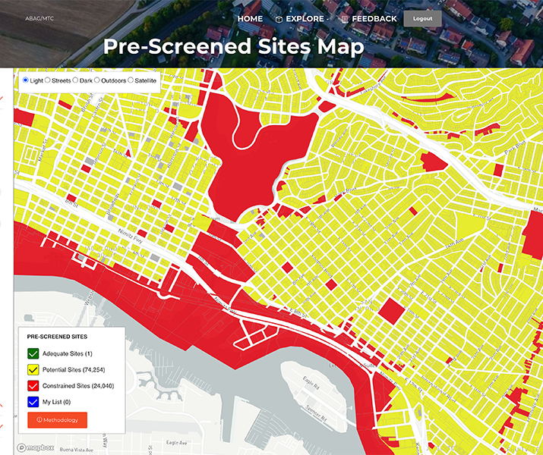
AB 686:
Outreach
Sites Inventory
New Housing Element Requirements
The site inventory to accommodate RHNA must now assess whether sites:
  Contribute toward replacing segregated living patterns with truly integrated and balanced living patterns
  Transform high poverty neighborhoods into areas of opportunity
We will be required to analyze sites for all income levels (not just low-income housing)
Notes:
[read slide]
HCD’s AFFH Data Viewer and ABAG’s HESS tool can help in this task

Slide 12
AB 686:
Outreach
ID and Prioritize Contributing Factors
New Housing Element Requirements
Based on the results of our outreach, assessment of fair housing and site inventory we will:
  determine the factors contributing to the creation and perpetuation of fair housing issues
Examples range widely e.g.,:
  community opposition to development
  exclusionary zoning codes
  lack of funding and resources

Slide 13
AB 686:
Outreach
Goals, Policies & Actions
New Housing Element Requirements
We must identify policies and programs with a schedule of actions to advance fair housing
  These must be connected to the fair housing issues and contributing factors.
Policies and actions can vary widely, depending on the fair housing issues we identify, e.g.:
  Few housing choices → increasing density, ADU policies, etc.
  High displacement rates/risk → tenant protections, rental assistance, etc.
  No subsidized housing → policies to increase funding, housing trust funds, public land disposition, etc.
  Affordable housing applicants don’t match demographics of residents → targeted outreach programs

Slide 14
Incorporating AFFH into our Housing Element
Key Takeaways
AB 686 makes this housing element update different than previous updates.
Extra scrutiny will be paid to our housing element update
  Several Southern California Jurisdictions have had their housing elements sent back over their compliance with AFFH
  We need to be careful about our sites inventory to ensure we aren’t reinforcing/creating segregation patterns and that we consider access to neighborhood resources
We will need to make sure community engagement is representative of our residents, especially protected classes
  It’s recommended that we track outreach demographics (race/ethnicity, owner/renter, etc.) and compare to our overall population

Slide 15
Next steps and resources
[insert Housing Element timeline or next steps in process]
Numerous resources exist from state and region to help us meet these new requirements:
  HCD links
    AFFH Webpage
    AFFH Data Viewer
    AFFH Guidance Memo
  ABAG TA
    ABAG’s Housing Technical Assistance website
    Housing Element Completeness Checklist
    Housing Needs Data Packets
    County Collaboratives
    Consultant grants
Notes:
Here are a list of key AFFH links from HCD- including the main website, the data viewer, and the AFFH guidance memo. Also ABAG’s housing TA website, HE checklist, the housing needs data packets, and a video presentation previewing ABAG’s research with UC Merced on segregation and land use.

Slide 16

Thank You.
[your email]
housingTA@bayareametro.gov
AFFHGuidance@hcd.ca.gov

