Slide 1
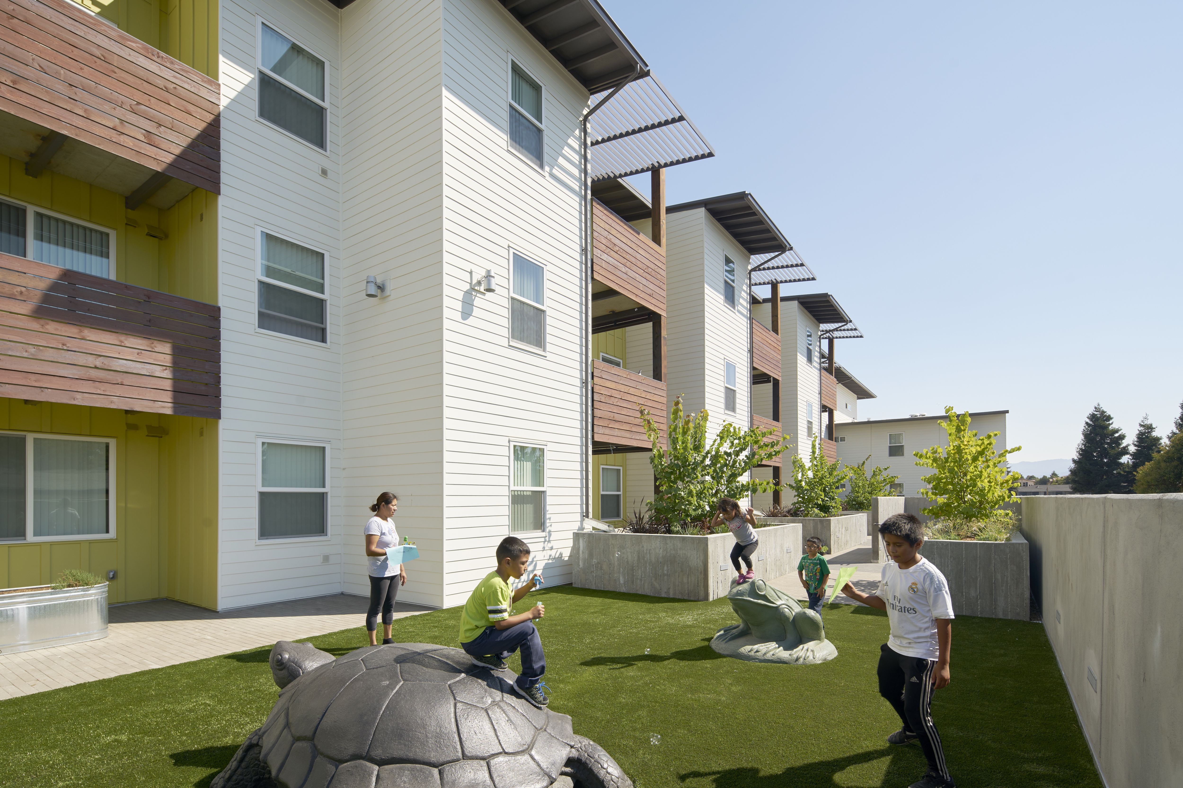
Santa Clara County Planning Collaborative Meeting
September 9, 2021

Slide 2
Agenda
Announcements (12:00-12:10)
Work Plan 3 Month Look Ahead (12:10-12:15)
Let’s Talk Housing Meetings Debrief (12:15 -12:45)
ADU Survey (12:45-1:00)
Fees and Processing Times (1:00 - 1:20)
Local Preference Policies Next Steps (1:20 - 1:25)
Close 1:30

Slide 3
Announcements
SB 9 Training – Josh
NPH Conference 9/24
https://nonprofithousing.org/events-and-programs/conference/
HCD Office Hours September 29, 1-3 PM
https://calendly.com/daisy-bd/hcd-office-hours-2?month=2021-09
Balancing Act
Other?

Slide 4
Look Ahead
Let’s Talk Housing Phase 2
-Meetings
-EAG Engagement
AFFH Research and Analysis for SC County
Finalize HESS Tool and Conduct Training/TA
Fees/Processing Times Survey and Memo
Local Preferences Ordinance Research

Slide 5

Review & Next Steps
Notes:
Paul introduce, hand off to daisy

Slide 6
LTH - Participation
Meeting 1 (Cupertino, Los Altos, Saratoga, Monte Sereno)
129 registrants
60 participants
Meeting 2 (Gilroy, Morgan Hill, Santa Clara County)
100 registrants
60 participants
Meeting 3 (Campbell, Los Gatos, Los Altos Hills)
104 registrants
50 participants
Meeting 4 (Santa Clara, Mountain View, Sunnyvale, Milpitas)
172 registrants
80 participants
Meeting 5 (San Jose)
347 registrants
100 participants
Notes:
Participant number is approximate
Daisy

Slide 7
LTH- Demographics Snapshot
Meeting 1 (Cupertino, Los Altos, Saratoga, Monte Sereno)
  50% age 50+
  46% White
  36% Asian
Meeting 2 (Gilroy, Morgan Hill, Santa Clara County)
  52% age 50+
  52% White
  35% Hispanic/Latinx
Meeting 3 (Campbell, Los Gatos, Los Altos Hills)
  67% White
  No age info
Meeting 4 (Santa Clara, Mountain View, Sunnyvale, Milpitas)
  67% age 50+
  48% White/White mixed
  32% Asian/Asian mixed
Meeting 5 – San Jose
  47% age 50+
  48% White
  16% Did not respond
  12% Hispanic/Latinx
Notes:
Daisy

Slide 8
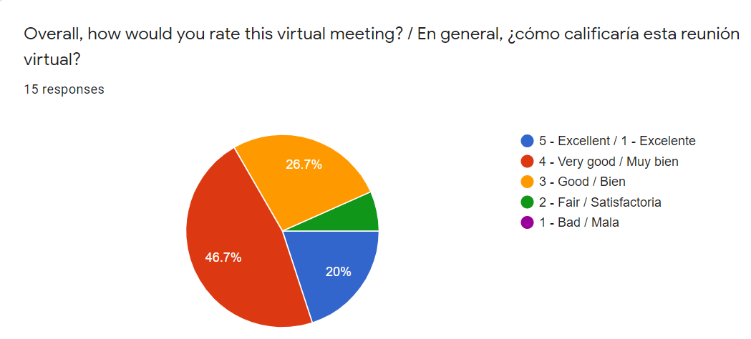
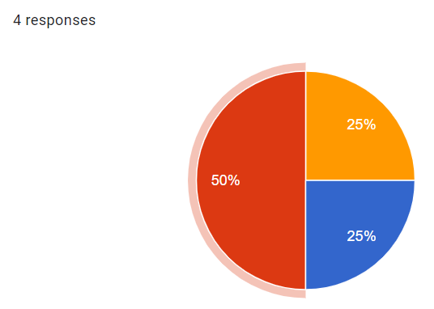
Participant Feedback
Meeting 1
(Cupertino, Los Altos, Saratoga, Monte Sereno)
Meeting 2
(Gilroy, Morgan Hill, Santa Clara County)
Notes:
Daisy

Slide 9
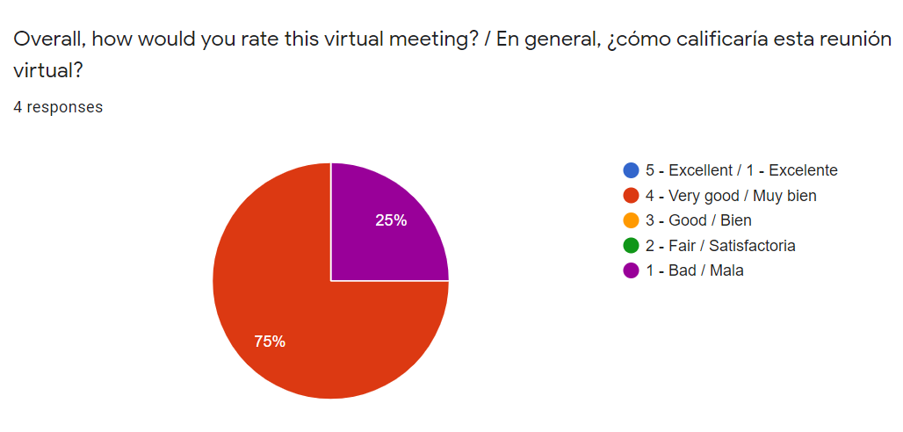
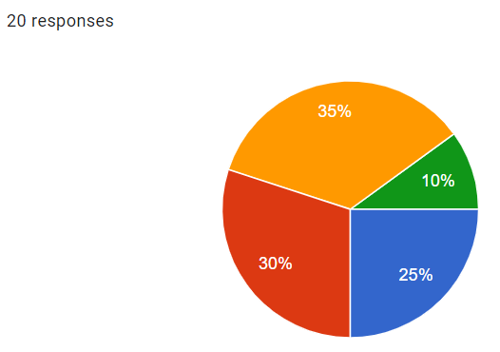
Participant Feedback
Meeting 3
(Campbell, Los Gatos, Los Altos Hills)
Meeting 4
(Santa Clara, Mountain View, Sunnyvale, Milpitas)
Notes:
Daisy

Slide 10
Next Steps
Posting session recordings on website
Share registrant list
Sharing jurisdiction contact info-- how to get involved
Meeting summaries
Notes:
Daisy
Meeting summaries– what type of summary would be most useful for you?

Slide 11
Staff Feedback
What worked well for you?
What could have been improved upon?
What are some lessons learned?
Notes:
Paul/Daisy

Slide 12
EAG Next Steps
Strategic EAG activities
Story-telling (videos, audio, written)
Happy Hour meet & greet
1-1 jurisdiction/community-based org meetings
Other possibilities
Notes:
Vu Bang

Slide 13
ADU Affordability Survey

Slide 14
About the study
15,745 postcards => online survey
  5% response rate
  Higher in ABAG area
UC Berkeley’s Summary –

Slide 15
Non-Affordability Takeaways
Most ADUs are used for long term housing - About 2/3 of ADUs are used for long term housing.
Many ADUs are available for friends or family – 16% of local ADUs (19% statewide) are available for no rent. An additional 13% of ADUs (16% statewide) are rented to a friend or family member.
Richer, white homeowners tend to build ADUs - Homeowners who make more than $200,000 were more than twice as likely to build an ADU than one would expect based on their share of the population.
Most ADUs are small – 81% of ADUs (79% statewide) are studios or have one bedroom
Detached ADUs remain popular – Many Marin ADUs (39% local/53% statewide) are detached units. 30% are attached. (This is one where we see regional variation.)
Challenges to ADU development persist – A majority of local ADU owners faced difficulties in navigating state and local regulations, the construction process, and in securing financing. Slightly more people (48%) felt getting local approval was not easy, compared to those who felt it was easy (41%).
Local = Marin, Sonoma, Napa

Slide 16
Usage
Table 3. Usage of Accessory Dwelling Units
Region | Friend/ Family Rental | Family - No Rent | Long Term Rental (Open Market) | Short Term Rental | Home Office | Other
East Bay | 12% | 19% | 27% | 2% | 14% | 27%
Peninsula | 16% | 18% | 28% | 4% | 14% | 20%
North Bay | 13% | 16% | 33% | 2% | 8% | 28%
Bay Total (9 Counties) | 14% | 18% | 29% | 3% | 13% | 24%
Statewide Total | 16% | 19% | 30% | 2% | 12% | 21%

Slide 17
Market Rate Rents

Slide 18
Market Rate Units By Affordability
Table 4. Affordability of Market Rate Units
 | Very Low | Low | Moderate | Above Moderate
East Bay | 0% | 15% | 70% | 15%
Peninsula | 6% | 31% | 48% | 15%
North Bay | 7% | 44% | 40% | 9%

Slide 19
Affordability – Including Nonmarket
Table 5. Market Rate and Discounted ADUs
Region | Friend/ Family Rental | Family - No Rent | Very Low Income Rents | Low Income Rents | Moderate Income Rents | Above Mod. Income Rents
East Bay | 20% | 33% | 0% | 7% | 33% | 7%
Peninsula | 24% | 28% | 3% | 15% | 23% | 7%
North Bay | 20% | 25% | 4% | 24% | 22% | 5%
Bay Total (9 Counties) | 22% | 28% | 2% | 14% | 26% | 7%
State-Wide Total | 24% | 28% | 1% | 9% | 23% | 14%
Adjusted for bedrooms, AMIs, etc.

Slide 20
Affordability – Including Nonmarket
Table 6. Affordability Including Family/Friends Rentals
Region | Very Low Income Rents | Low Income Rents | Moderate Income Rents | Above Mod. Income Rents
East Bay | 33% | 27% | 33% | 7%
Peninsula | 31% | 39% | 23% | 7%
North Bay | 29% | 44% | 22% | 5%
Bay Total (9 Counties) | 30% | 36% | 26% | 7%
Statewide Total | 29% | 33% | 23% | 14%

Slide 21
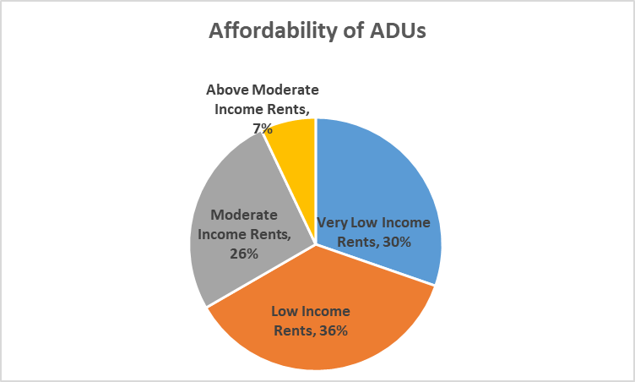
Recommendations
 | Very Low Income Rents | Low Income Rents | Moderate Income Rents | Above Mod. Income Rents
 | 30% | 30% | 30% | 10%
Figure 1: Affordability of ADUs
* AFFH caveat

Slide 22
Fee and Permit Processing Times
Break into groups and review/discuss survey tool

Slide 23
Local Preference Policies
4 Jurisdictions Currently Have Policy
7 Jurisdictions Interested in Creating or Updating existing policy
Work Completed to date: detailed case studies
Nest Steps:
Create model disparate impact study?
Collaboration across cities?

Slide 24
Looking Ahead
  Next Collaborative Meetings
    October 14th, 2021
    November 18th, 2021
    December 9th, 2021

