Slide 1
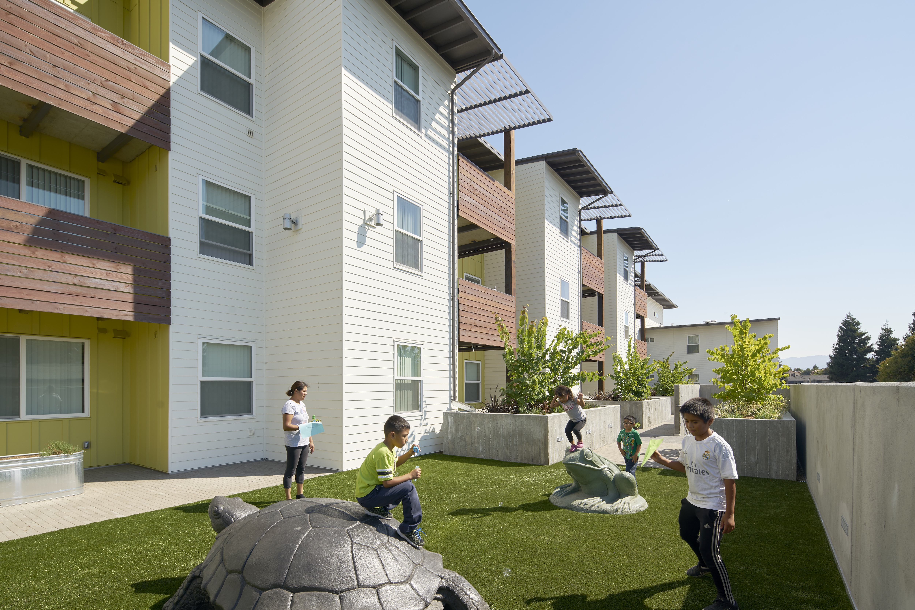
Santa Clara County
Planning Collaborative Meeting
March 11, 2021

Slide 2
Agenda
Welcome + Agenda Overview
HCD Representative Introductions
Announcements + Updates
Community Engagement Best Practices
REAP and Regional Resources
Group Exercise
Next Meeting 4/8/2021

Slide 3
Announcements
State APR’s due on 4/1/2021
Housing Element Sites Analysis One-on-One Meetings
ADU Affordability Survey
Other?

Slide 4
Product Updates
Jurisdiction Housing Element Budgets
Inclusionary/In-Lieu Fee Survey
Objective Design Standards (Budgets?)
Affordable Housing 101 and FAQs
All available on the web site!
https://citiesassociation.org/rhna-6/
https://citiesassociation/org/planning-collaborative-resources

Slide 5
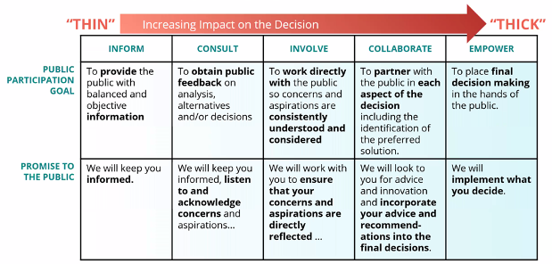
Community Engagement Best Practices
Community Engagement Spectrum
Notes:
Civic Makers, an engagement firm based out of San Francisco, recently shared some helpful frameworks at NPH and how they applied them to an affordable housing project in Santa Clara County. Before we share the project, lets do a quick overview.
What is our goal, what is our promise to the community and how are we guiding the process.
The first is the Community Engagement Spectrum, which is considered the gold standard when designing a public process.
No level is better and different aspects of a project might require different levels of engagement
A project can also evolve the level of engagement as it progresses – it may need to be expanded or reassessed
It is important to define what level a project or aspect of a project is at so everyone involved is in agreement
This sets up a transparent process with the community

Slide 6
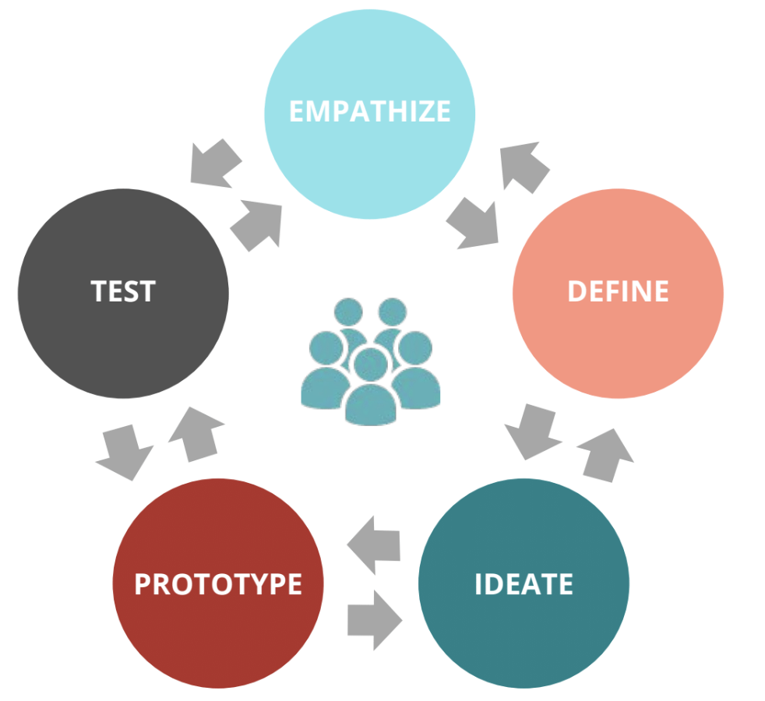
Best Practices
Human Centered Design
Notes:
The second is Human Centered Design, which is a non-linear, iterative, creative problem-solving framework for a public process.

Slide 7
Best Practices
Human Centered Design
Empathize
understand audience
Define
iterative, includes redefining
Ideate, Prototype and Test
create, get feedback, iterate
Notes:
It includes:
Empathize – understand who you are trying to reach
Define – an iterative process that includes redefining as we go and are getting feedback
Ideate, Prototype and Test – create, get feedback, iterate to make next version

Slide 8
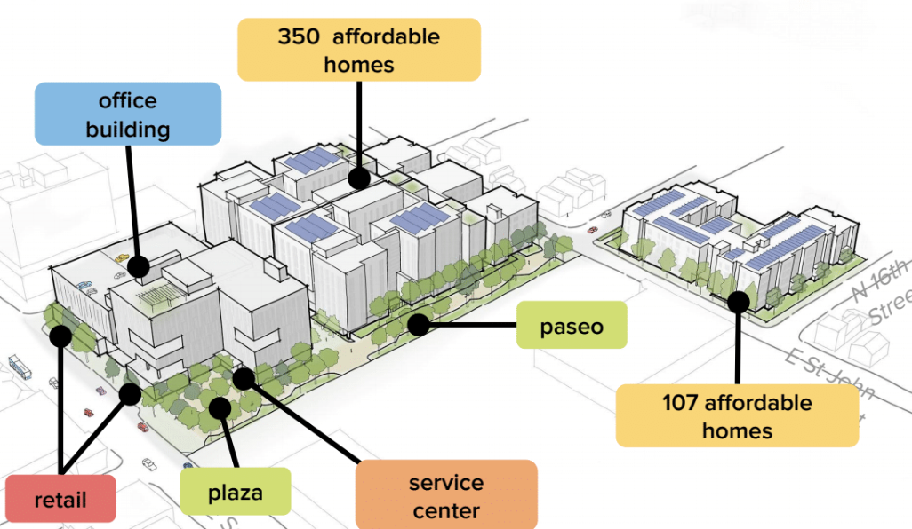
Best Practices
Santa Clara County Housing Authority Mixed Use Development Design: Concepts in Practice
Notes:
Civic Makers applied these concepts in there current work with the Santa Clara Housing Authority and David Baker Architects. They are getting feedback from a diverse group of neighbors on a a mixed-use development design.

Slide 9
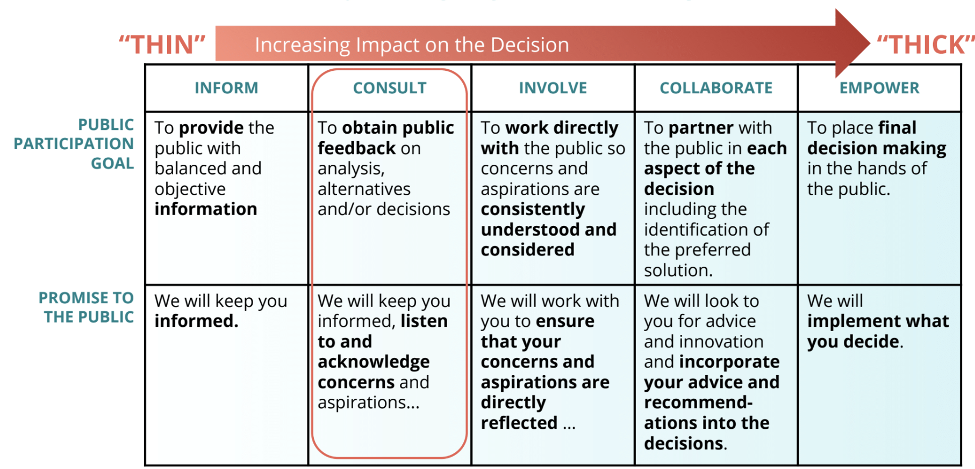
Best Practices
Santa Clara County Housing Authority Mixed Use Development Design: Concepts in Practice
Notes:
They began by identifying the level of engagement as Consult because the goal was to get feedback on predetermined design options.
Obtain feedback as the goal and keep the public informed while listening to their concerns as the promise to the public
Probably similarly to how we would begin the RHNA engagement.

Slide 10
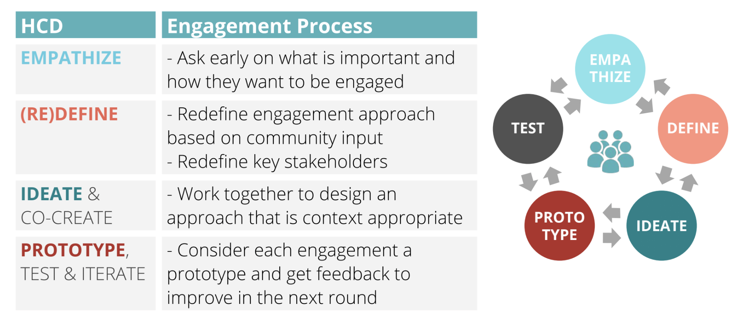
Best Practices
Santa Clara County Housing Authority Mixed Use Development Design: Concepts in Practice
Notes:
They then applied the Human Centered Design model, which ends up looking like this – a broad guideline for all activities

Slide 11

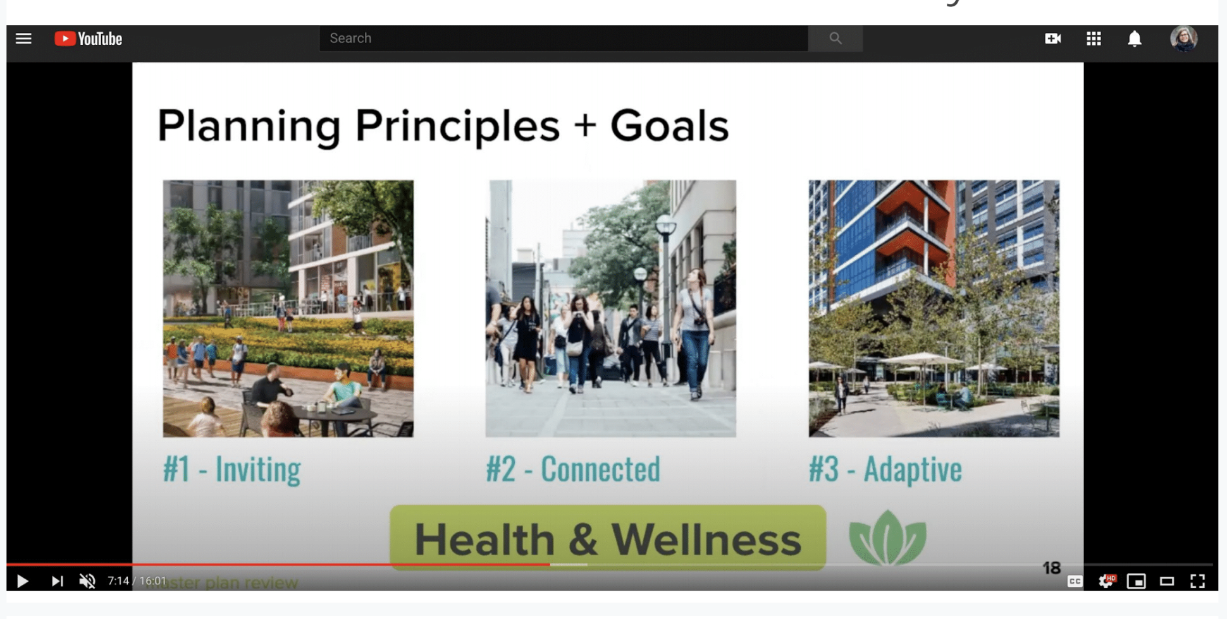
Best Practices
Santa Clara County Housing Authority Mixed Use Development Design: Concepts in Practice
Engaged in multiple ways
Latinx community members conducted outreach
Video and online survey
Text and email audiences
2nd Version: Virtual Q&A and Spanish-speaking approach
Notes:
They engaged in multiple ways – people could text in ideas, go to the website and use a map tool, they set up a pop up at the farmers market. They also presented at existing community meetings, and provided email updates.
After the initial phase of engagement they wanted to increase engagement from the Latinx community
Found women active in the Latinx community to conduct cultural and linguistic outreach on their behalf – door to door, churches, materials in the community
Had planned for a robust in person process, but due to Covid moved to virtual platform
Recorded a webinar which was available on YouTube and linked to a mobile friendly survey
Determined needs for both a text and email audience for on-going engagement and feedback
Worked with partners to refine
Second version included a live virtual Q&A with a built out approach for Spanish speaking community including calls and collateral
They received overwhelmingly positive feedback and continue to iterate as the process continues

Slide 12
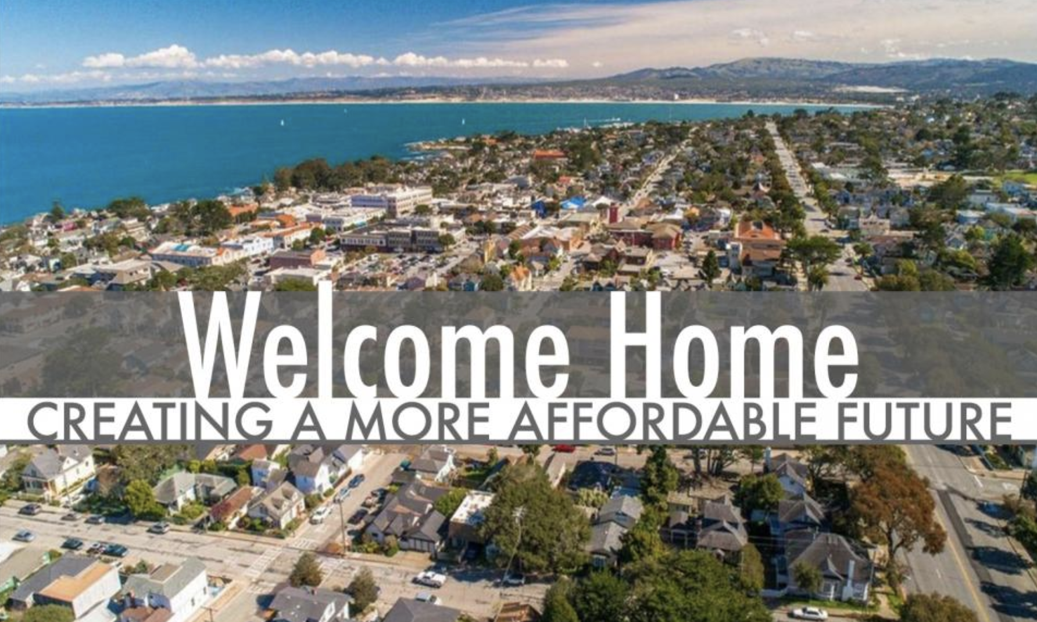
Best Practices
Pacific Grove: Welcome Home
Notes:
We are currently working on Pacific Grove: Welcome Home, a planning and action initiative to create more diverse and affordable housing options. It is a precursor to their Housing Element update.

Slide 13
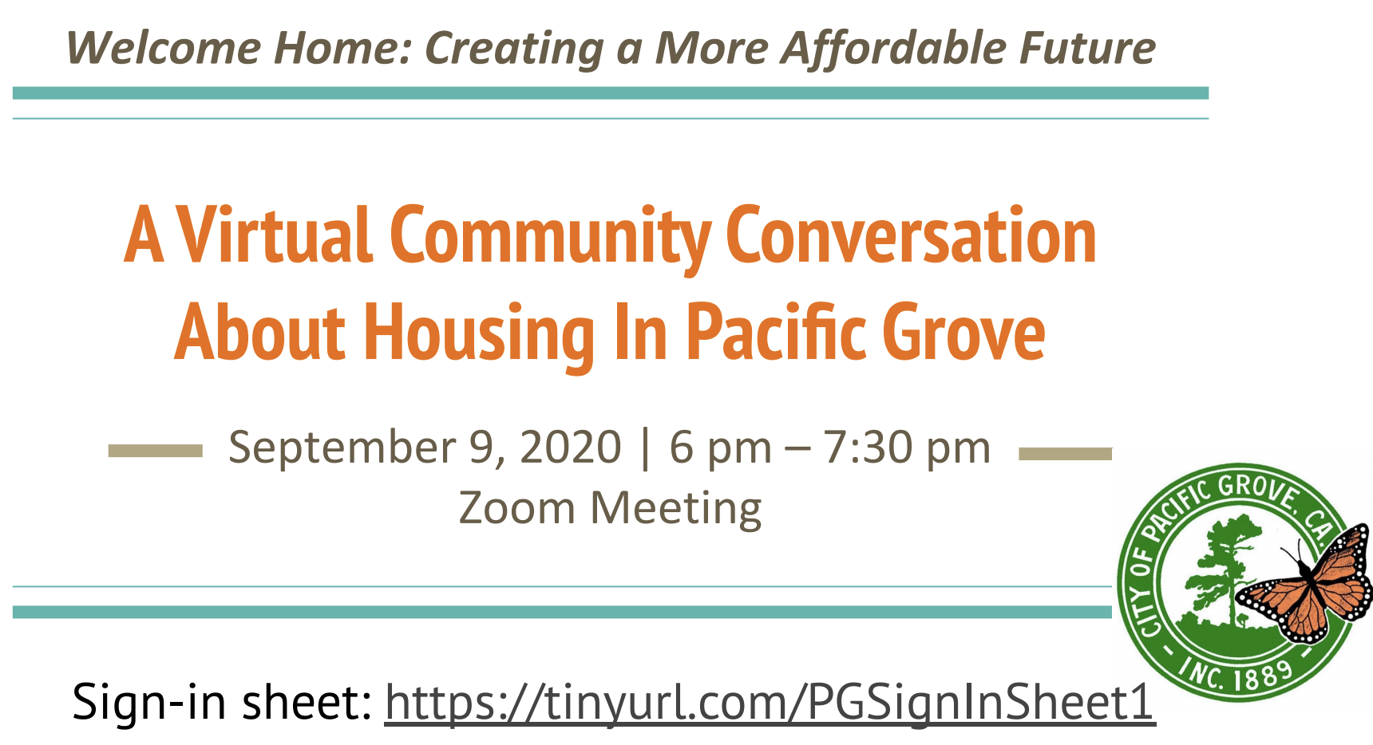
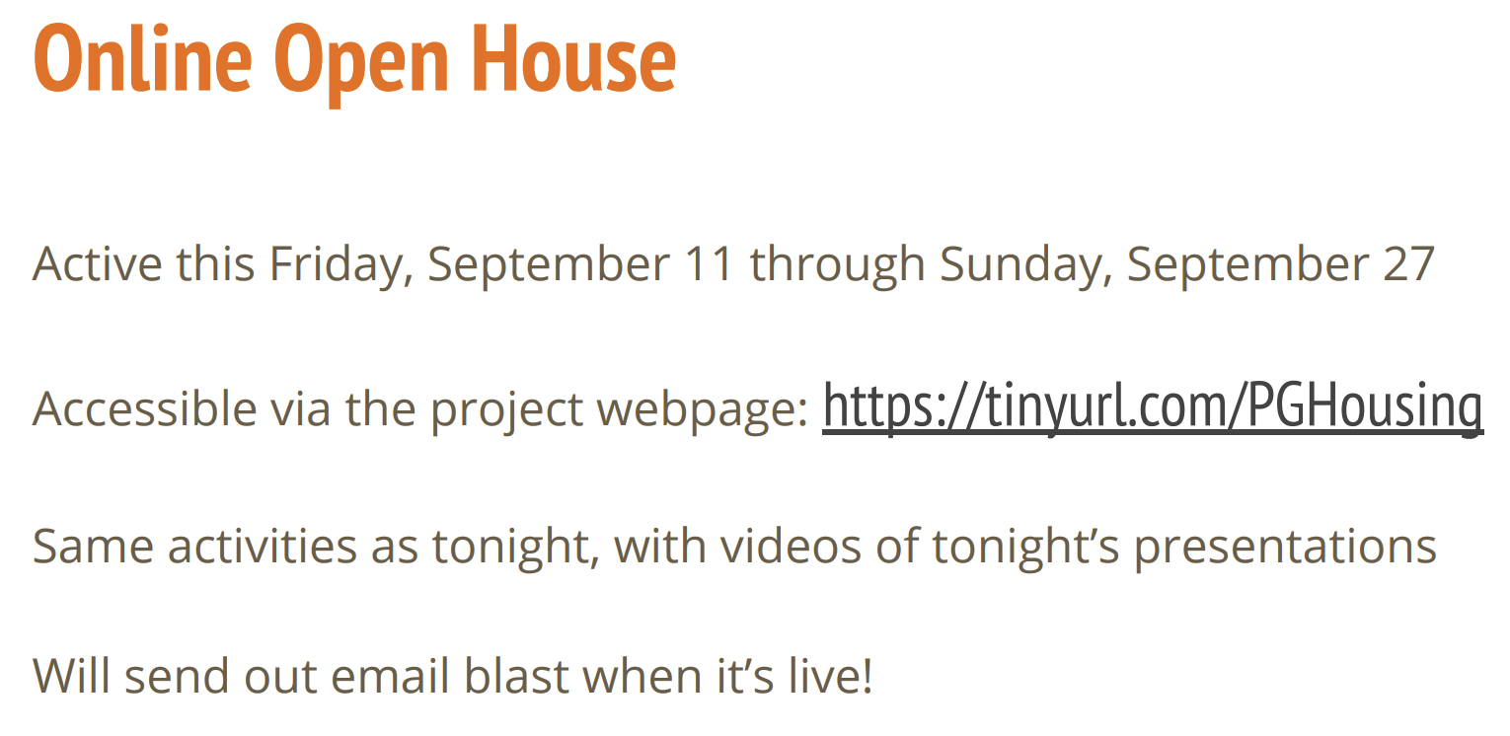
Best Practices
Virtual Live Meetings
65+ participants
Facilitated breakout rooms
Spanish language focus group
Online Open House
English and Spanish
Two weeks (125 participants)
Videos embedded in SurveyMonkey
Link to Site

Slide 14
REAP Plans
Notes:
INSERT VuBang Slides Here

Slide 15
Tools
For Online Engagement
Engagement HQ – used by Civic Makers in Santa Clara example for all aspects of a community engagement
  Kansas City Example
  Demo
Mentimeter – word clouds
  A sneak peak at your homework
Miro – collaborative online whiteboard for meetings
  A sneak peak at your homework
Mural - digital workspace for visual collaboration

Slide 16
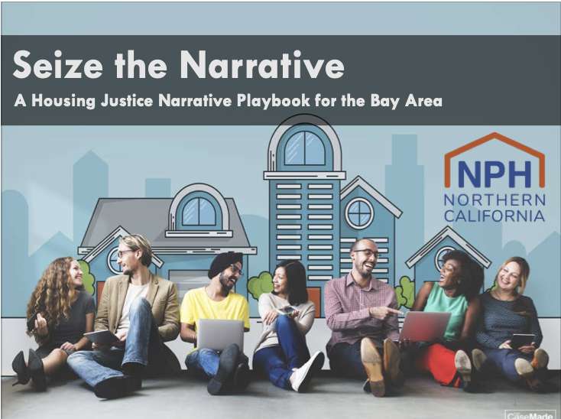
Resources
For Online Engagement
Seize the Narrative: A Housing Justice Narrative Playbook for the Bay Area by NPH
Beyond Checking the Box: Creating Equity Through Innovative Community Engagement – presentation from NPH Conference 2020 (video)

Slide 17
Let’s Talk Housing
Materials
Graphics and text newsletters, social media, city websites
Additional text for your use
One pager for community

Slide 18
Group Exercise
What does successful community engagement look like in Santa Clara County?
Beyond tools and resources, do we want/need a regional collaboration like that being developed for 21 Elements?
What local groups or partners should be involved?

Slide 19
Word Cloud
What word or words would you use to describe successful community engagement?
https://www.menti.com/6i6gj217mw
The voting code 1855 8708

Slide 20
Upcoming Meeting Schedule & Topics
April 8, 2021 – Local Preferences
May 13, 2021 – Sites Analysis 201?
June 10, 2021 - ?

